Slide 1
Live Under Open Heavens
Ps. Ludwig Easton
28/01/2018

Slide 2
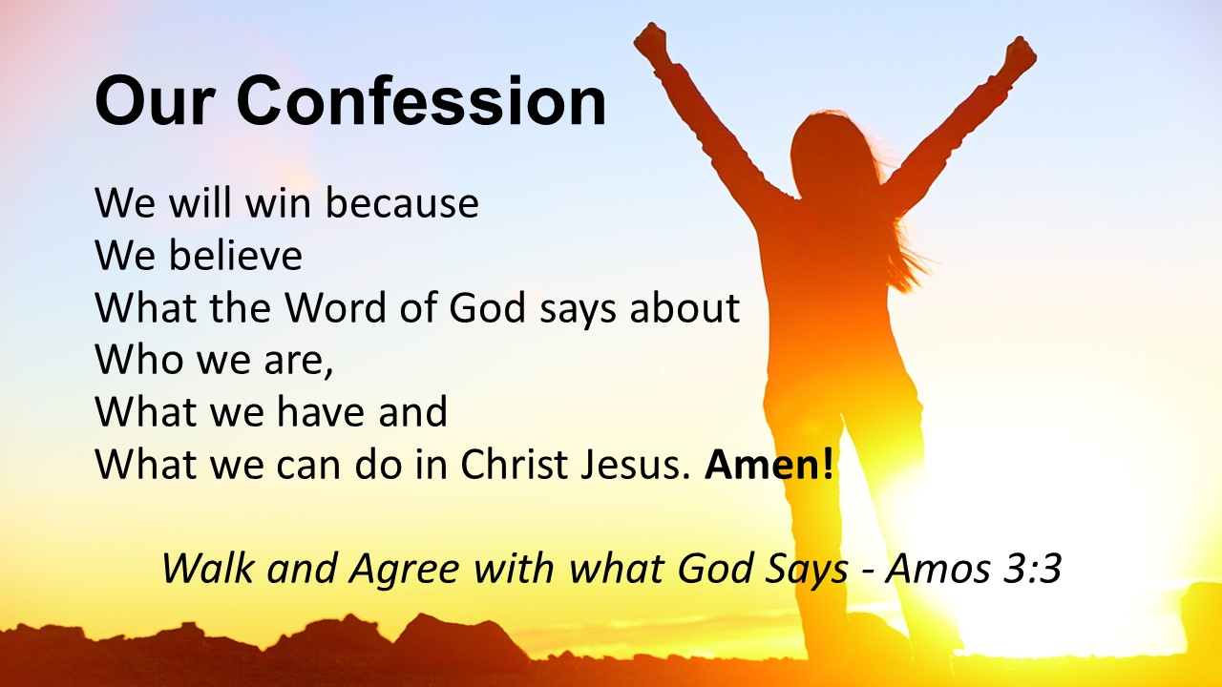
What does God say about us?

Slide 3
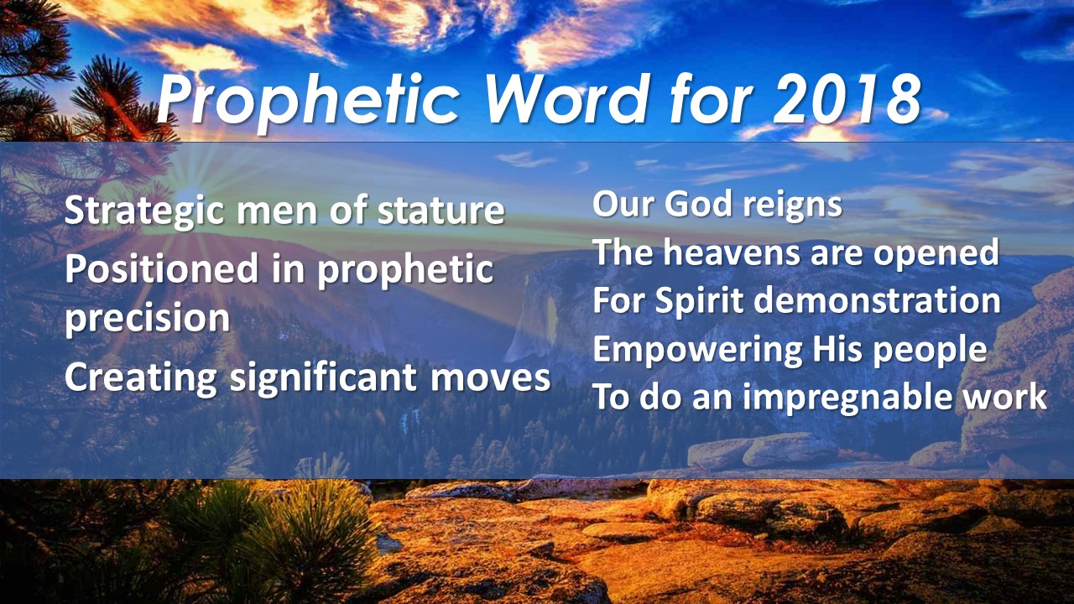
What does God say about us?

Slide 4
Ephesians 1:10
¹⁰ that in the dispensation of the fullness of the times He might gather together
in one all things in Christ, both which are
In heaven and which are
on earth—in Him.

Slide 5
Deuteronomy 11:21 (NKJV)
²¹ that your days and the days of your children may be multiplied in the land of which the Lord swore to your fathers to give them, like the days of the heavens above the earth.

Slide 6
Deuteronomy 11:21 (KJV)
²¹ That your days may be multiplied, and the days of your children, in the land which the Lord sware unto your fathers to give them, as the days of heaven upon the earth.

Slide 7
How To Live Under Open Heavens
Be Conscious of God’s Presence, and walk in God’s Protection (Gen 28, John 1:14, Ps 91).
Obey the Word (Christ) and Experience God’s Progress (Matthew 3: 13-17, Luke 3:21-22, Mark 1:9-11)
Heed the Father’s voice; hear the Proceeding Word (Is 6:1-13, Rev 4, Ezekiel 1:1-3, Matthew 3: 13-17, Luke 3:21-22, Mark 1:9-11, Ps 78:23-25)
Giving to the local church (Storehouse), releases God’s Provision & Prosperity (Malachi 3:8-10)
When we are United, we will be filled with God’s Power from on High
Prayer that has the power to Prevail (Luke 3:21-22, Luke 11:2-4, Matthew 16:13-16)
Proclamation (voice) that creates Pathways in the Spirit (Acts 2:14, 40-43, John 1)
Worship at the throne that draws God’s Presence (Rev 4 & 5, John 4:23-24)

Slide 8
1. Be Conscious of God’s Presence, and walk in God’s Protection
Don’t miss Him when we come to church
The Jews missed Him (John 1) – We can’t receive from Him if we don’t recognise Him (Honour)
We are God’s House and temple
When we are conscious of Him, we don’t have to be intimidated by the enemy
He who is in me is stronger than He who is in the world

Slide 9
2. Obey the Word (Christ) and Experience God’s Progress
Jesus fulfilled all righteousness
He pleased the Father
Without faith it is impossible to please God (Hebrews 11 – by Faith…)

Slide 10
3. Heed the Father’s voice; hear the Proceeding Word
Uzziah must die
As long as Uzziah is alive, we can’t see
Perception is not accurate

Slide 11
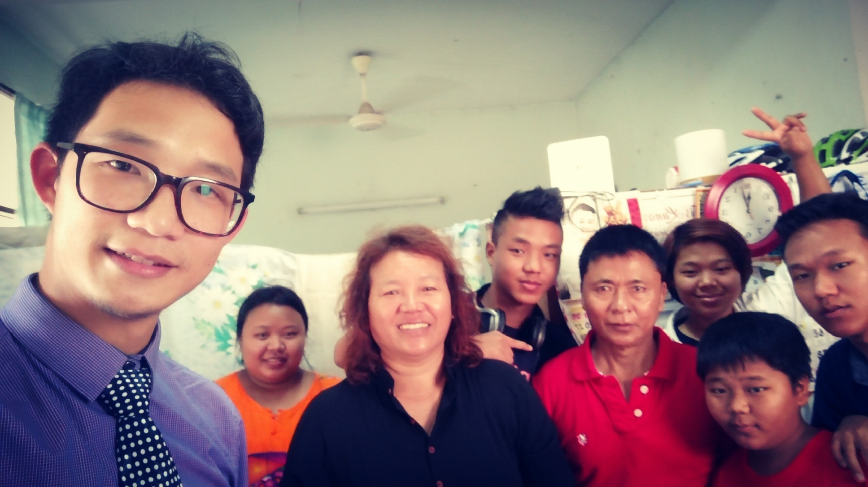
4. Giving to the local church Releases God’s Provision & Prosperity

